Slide 1
Sources of Health Data Part II
National Surveys (contd.) and other sources

Slide 2
Outline
Example National Survey: NHANES
Other sources of health data

Slide 3
Example National Survey: NHANES
We will focus on NHANES survey in detail
NHANES is the most comprehensive survey among the national surveys on health data presented last week
We will focus on how to retrieve data files from the NHANES site directly
Learn how to Import NHANES data from the site to R

Slide 4
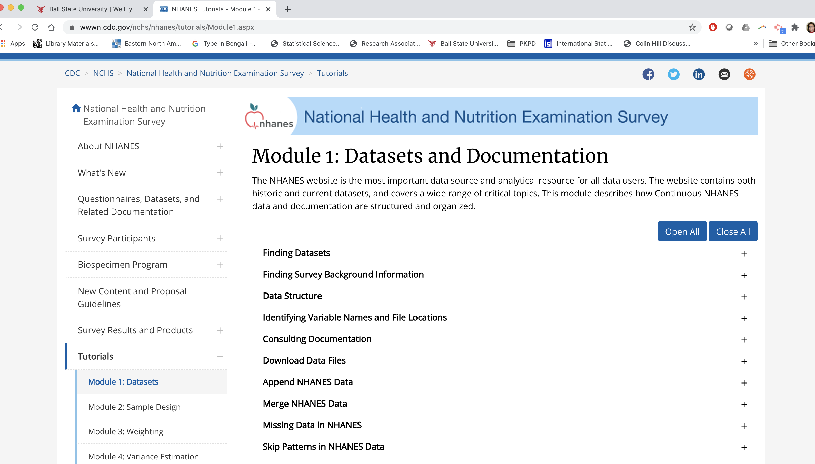
NHANES Datasets and Documents

Slide 5
NHANES Datasets and Documentation (contd.)
Expand and review the Finding Datasets tab
Each NAHANES survey cycle page (e.g., NHANES 2015-2016) contains documentation about the survey, documentation on how to use the data and links to each of the component pages
The survey cycle page has the following information on
Demographics Data
Dietary Data
Examination Data
Laboratory Data
Questionnaire Data

Slide 6
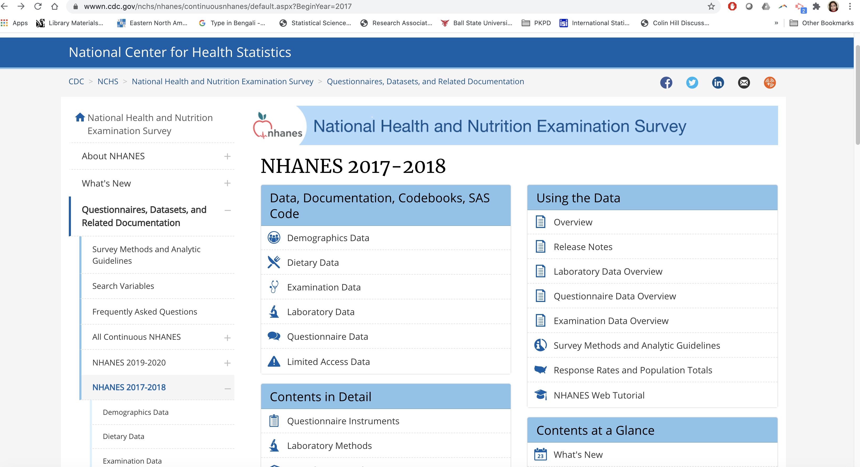
NHANES Data and Documentation

Slide 7
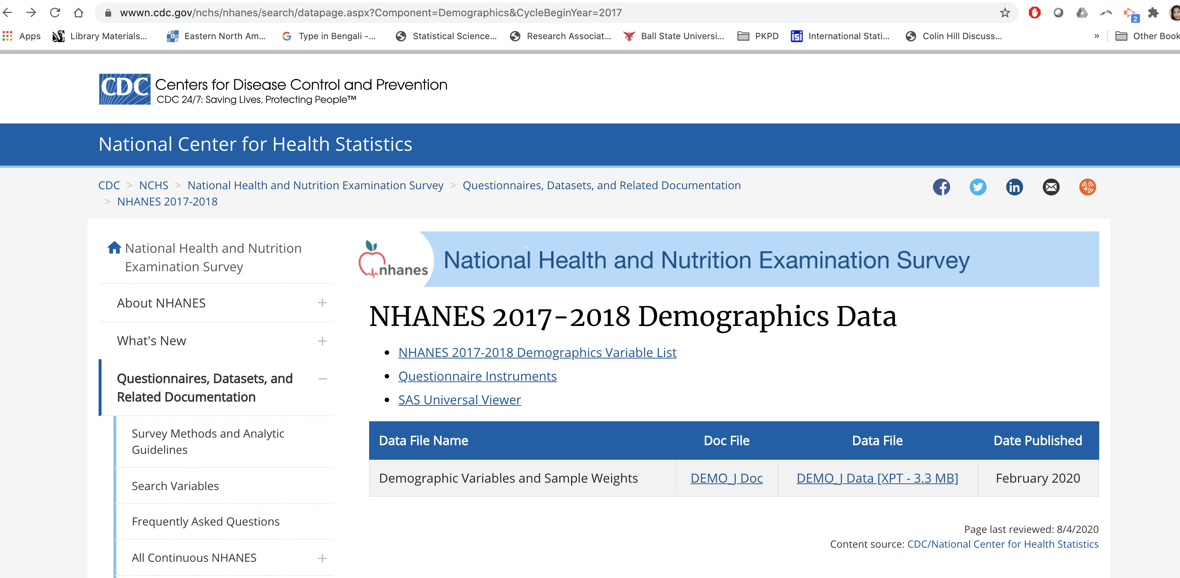
Data, Documentation, Codebooks, SAS Code
If you click on Demographics Data under the Data, Documentation, Codebooks, SAS code, you will see the page on the right
The Doc file has the data documentation and the codebook you need to get familiar about the data and variables

Slide 8
Data, Documentation, Codebooks, SAS Code(contd.)
The Data file has the data in SAS XPORT format
You can use SAS universal viewer to view the data
However, we will use R to import the .xpt file into R and view from there
Watch the video on NHANES data retrieval to see the steps

Slide 9
Data, Documentation, Codebooks, SAS Code(contd.)
Following the same steps as in Demographics Data, you can review the documentation and codebook for Dietary Data, Examination Data and so on.
Dietary, Examination, Laboratory, and Questionnaire data has multiple data sets
To demonstrate the data retrieval, I will consider an additional data file from these tabs

Slide 10
Other Sources of Health Data: Electronic Health Records (EHR)
EHR provides patient’s medical record in detail including history, physical examination, investigations, and treatment in digital format
Adoption of EHR can increase access to health care, improve the quality of health and decrease costs
However ethical issues related to EHR and security breaches should be dealt with seriously
Since 2008, National Center for Health Statistics (NCHS) started the national electronic health records survey (NEHRS)
NEHRS data can be used to estimate state and national level EHR adoption rate, capabilities, burden of EHR etc.

Slide 11
Health data from mobile devices
mHealth (abbreviation for mobile health) is a recent term used for the practice of medicine and public health supported by mobile devices
Smart phones, tablet computers, personal digital assistants, and wearables such as smart watches, accelerometers can capture various types of data and store them to network servers
Apple HealthKit (for iOS) and Google Fit (for Android) integrate variety of health-related data and provide a universal source of such data with explicit consent by the user

Slide 12
Internet of Medical Things (IoMT) and Social Media
IoMT refers to networked interconnection of medical devices
IoMT has tremendous ability to collect, analyze and transmit health data
For patients and clinicians applications of IoMT are playing a central role in tracking and preventing chronic illnesses
Facebook, Twitter, blogs and other social media can also be an important source of health data

Slide 13
Next week:
We will discuss on
Prospective Study Designs
Retrospective Study Designs
Randomized Controlled Trials

